Slide 1
Capstone Project Third Review
GROUP:
DEVARAKONDA SRI HARSHA-19BEV7028
RAMANNAGARI DIVYA-19BEV7039
BYSANI SAI RAMESH-19BEV7016
Guided by: Dr. CHANDAN KUMAR PANDEY
Assistant Professor Senior Grade-1, PC(ECE-VLSI)

Slide 2
Agenda
Problem Statement
Methodology
Simulation of device and results
Novelty
Objectives Met
Applications
Conclusion
Timeline and References

Slide 3
PROBLEM STATEMENT
JLFET GAA: Design Optimization With Triple Metal-Gate
Software Used : Silvaco TCAD

Slide 4
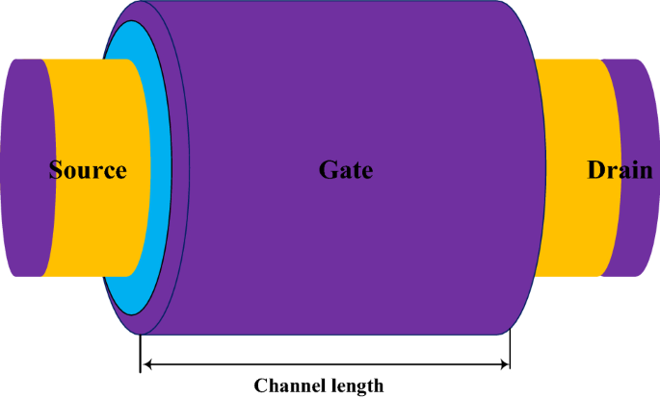
Methodology

Slide 5
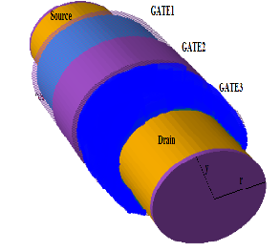

Slide 6
Simulation of device and results

Slide 7
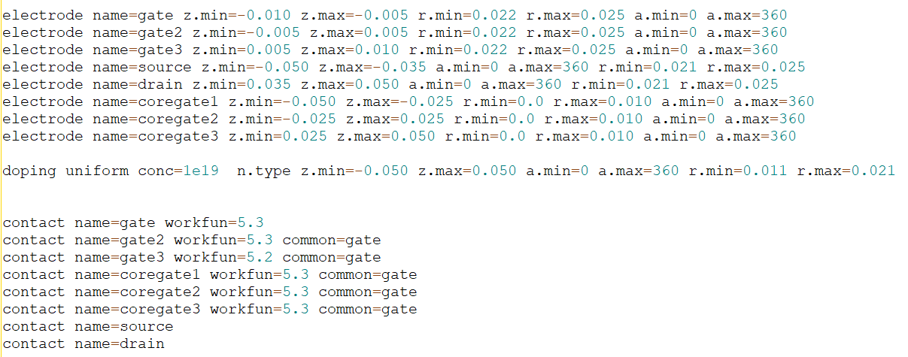
Major changes in code:

Slide 8
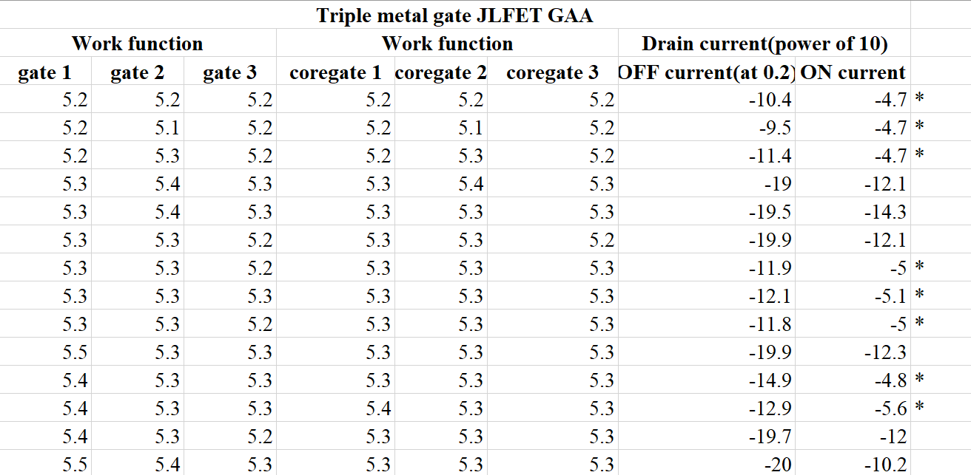
ON current and OFF current for different values of workfunction:

Slide 9
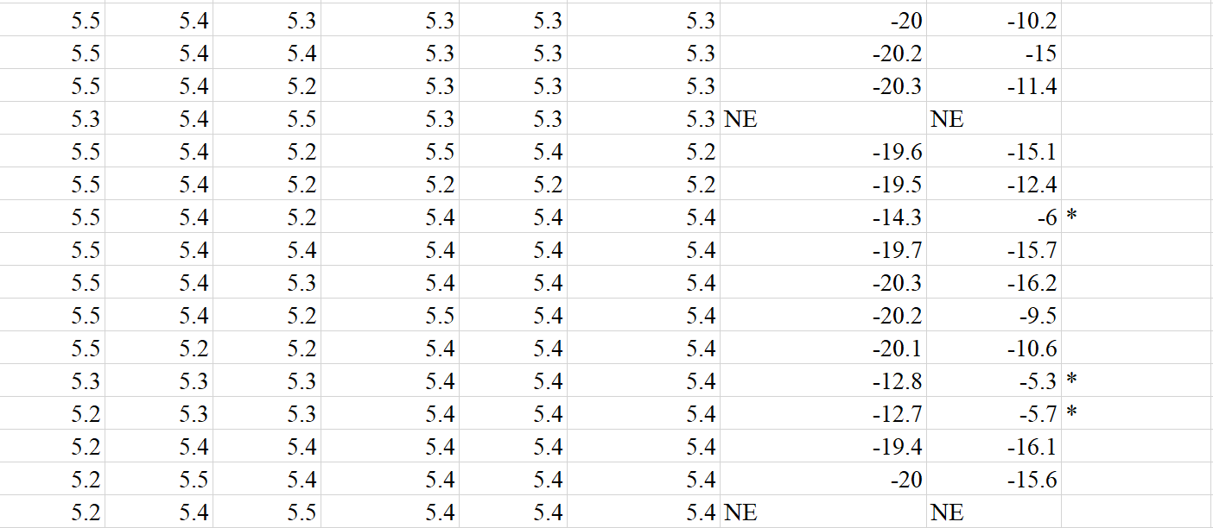

Slide 10
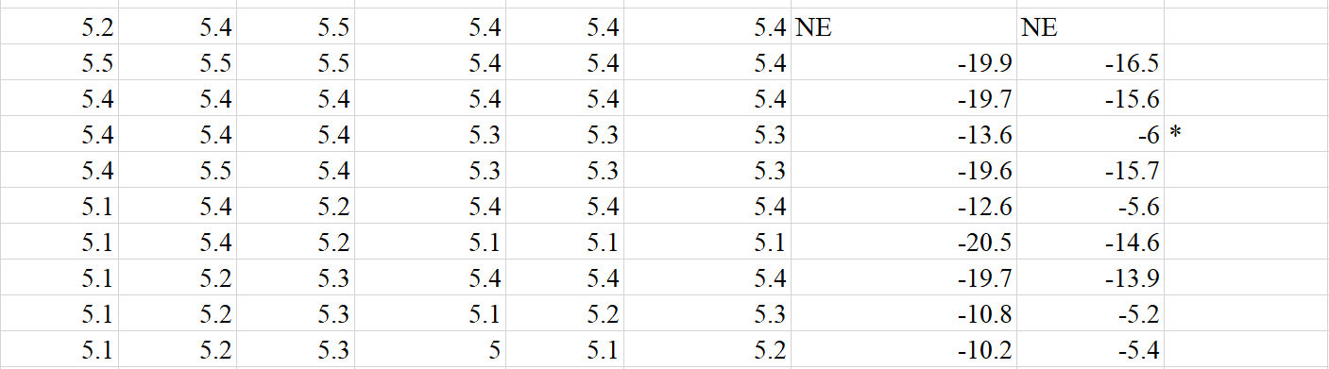

Slide 11
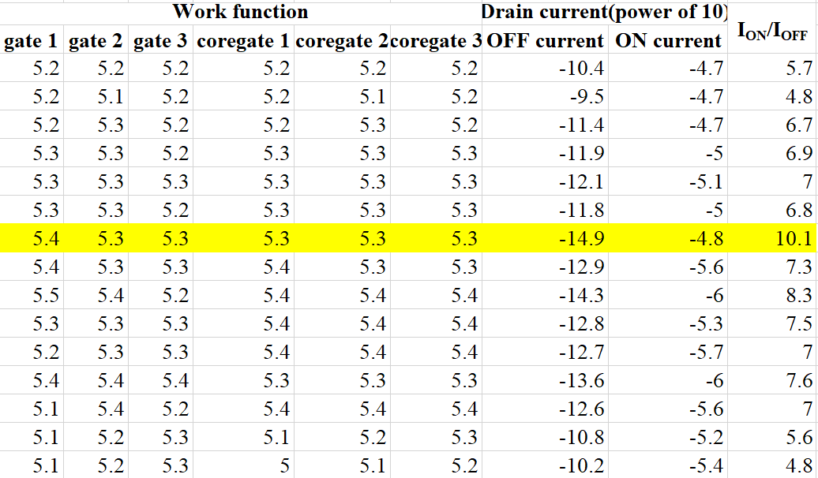
FINAL RESULTS:

Slide 12
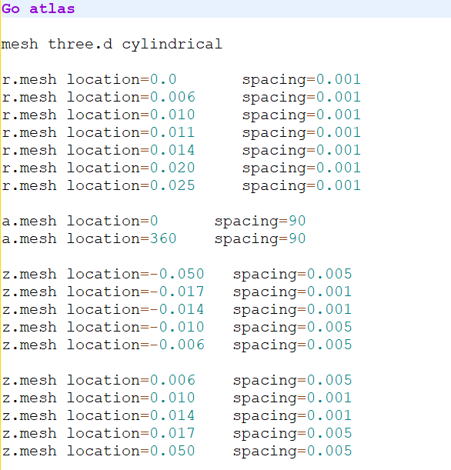
FINAL CODE:

Slide 13
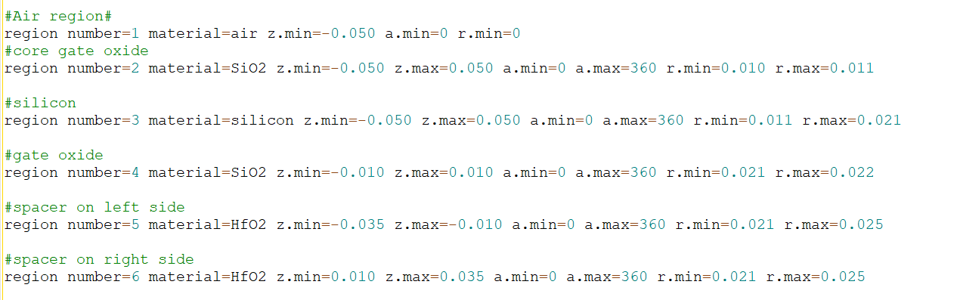

Slide 15
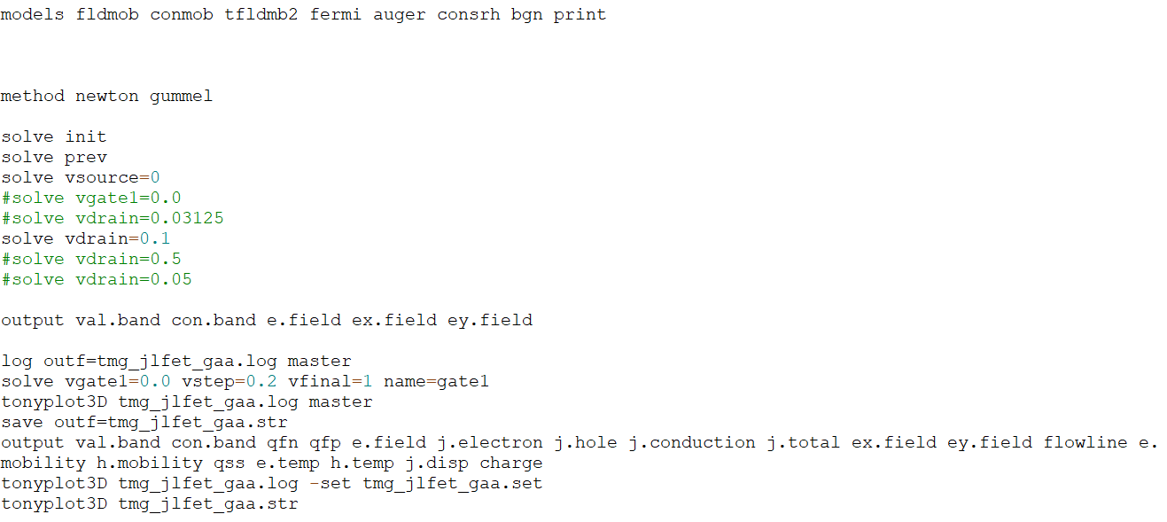

Slide 16
RESULTS

Slide 17
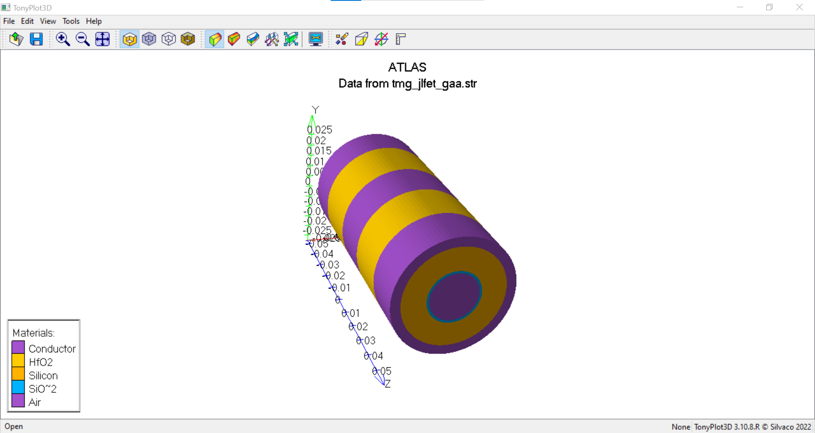
Device Structure

Slide 18
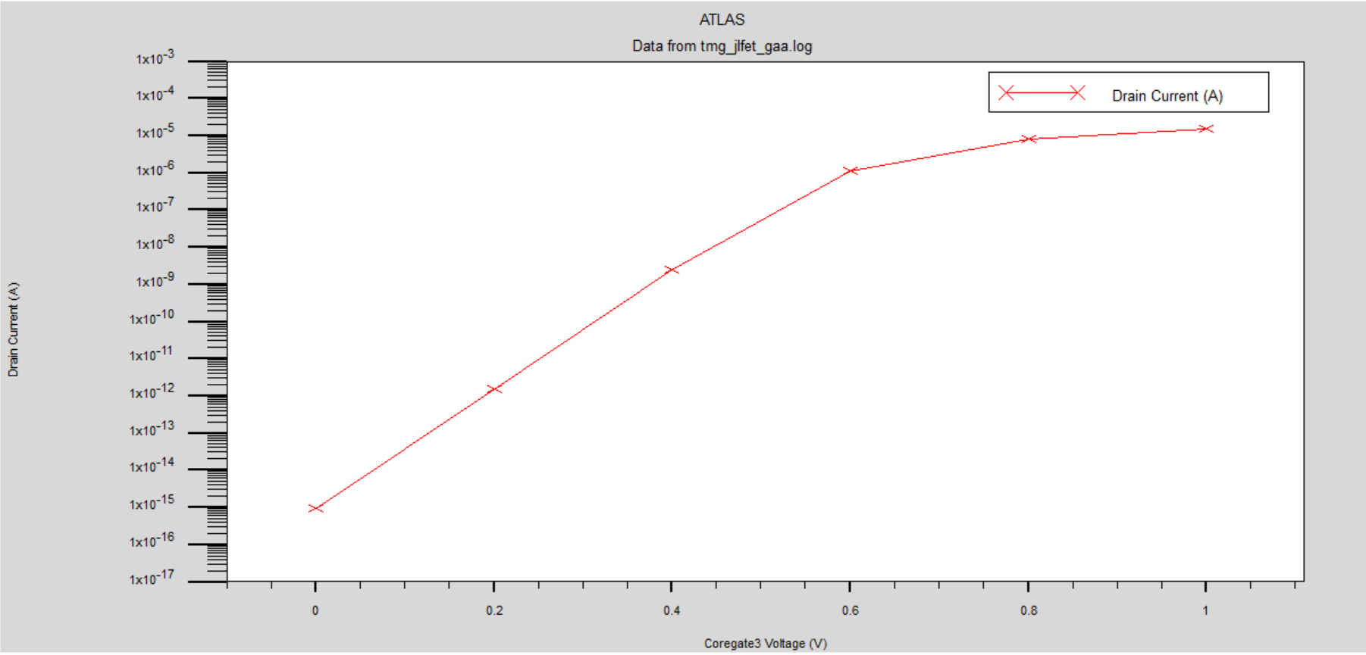
Transfer characteristics(Id-Vg Plot)

Slide 19
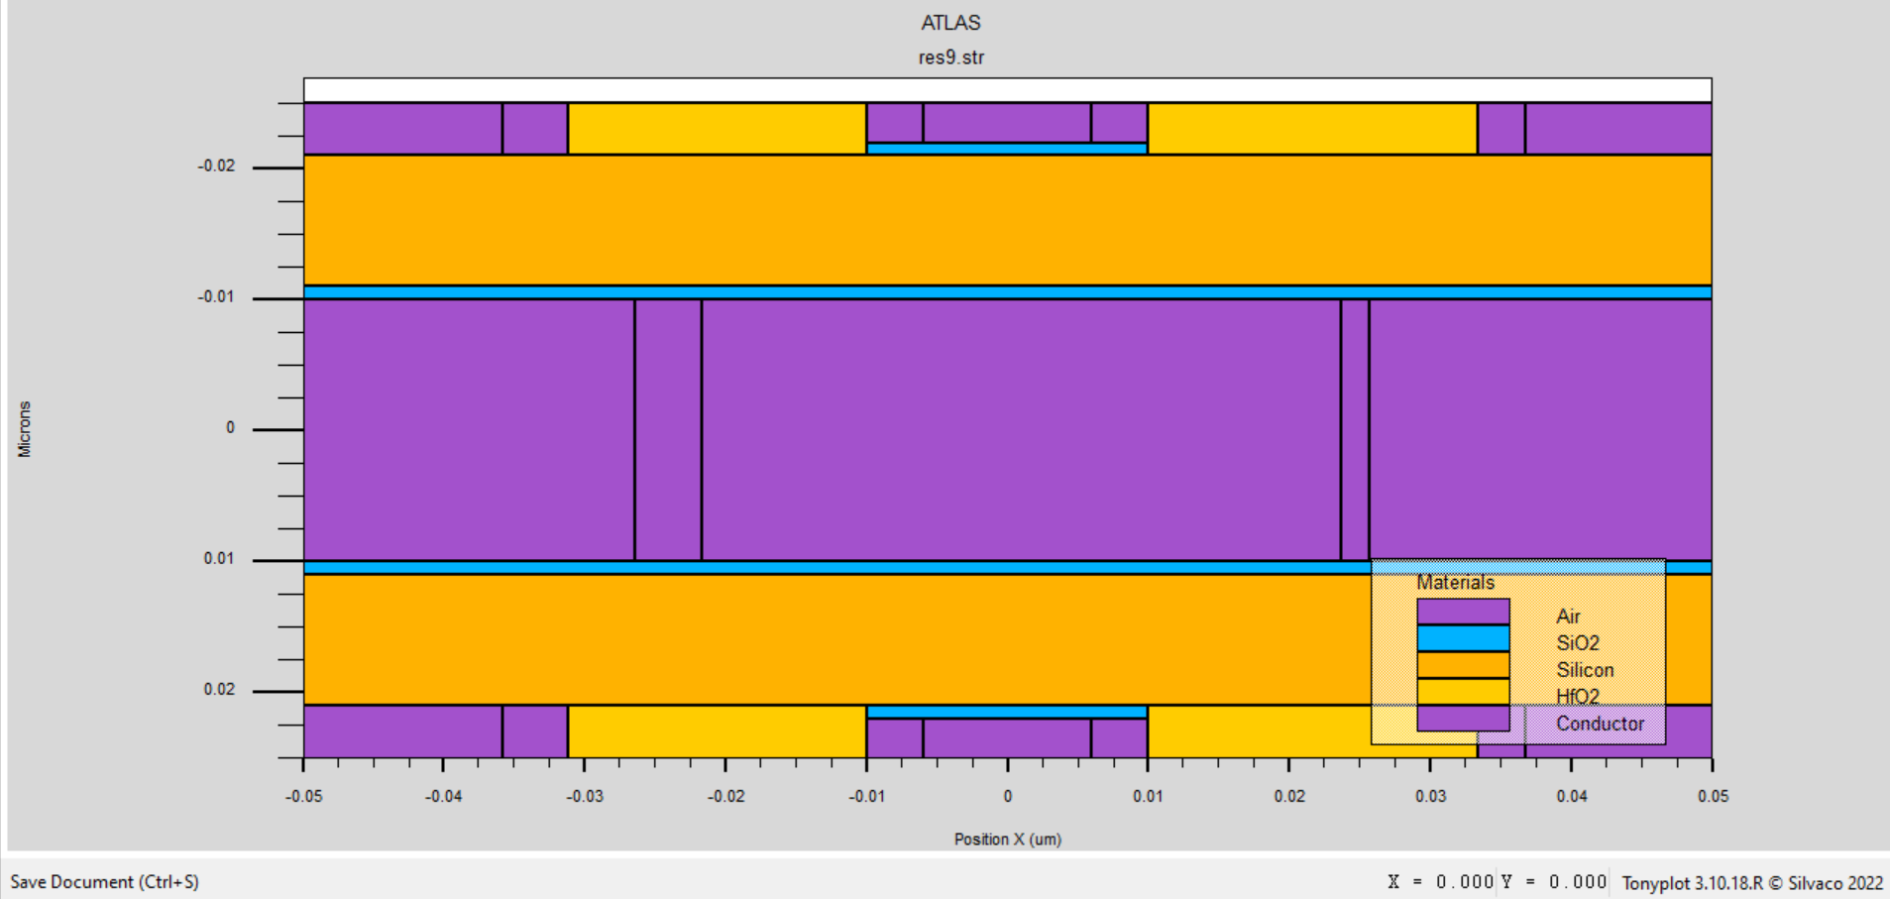
2-D structure

Slide 20
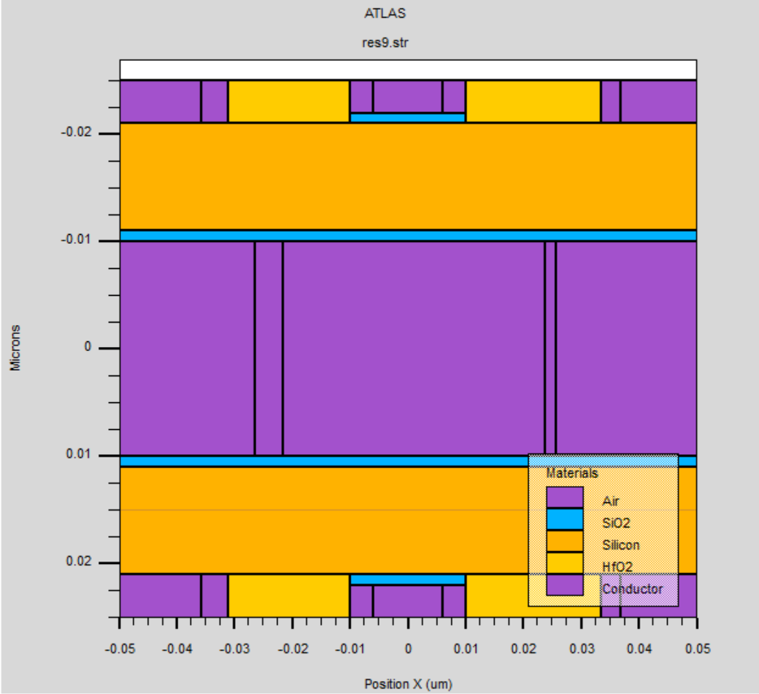
Cutline

Slide 21
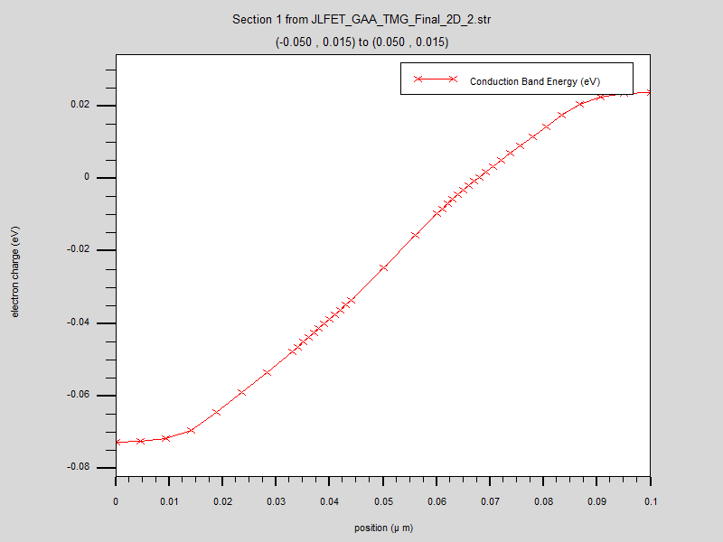
conduction band energy graph

Slide 22
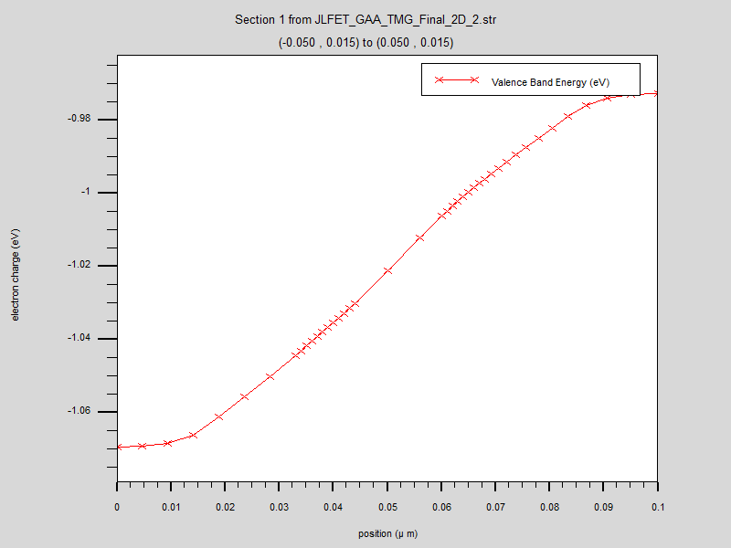
valence band energy graph

Slide 23
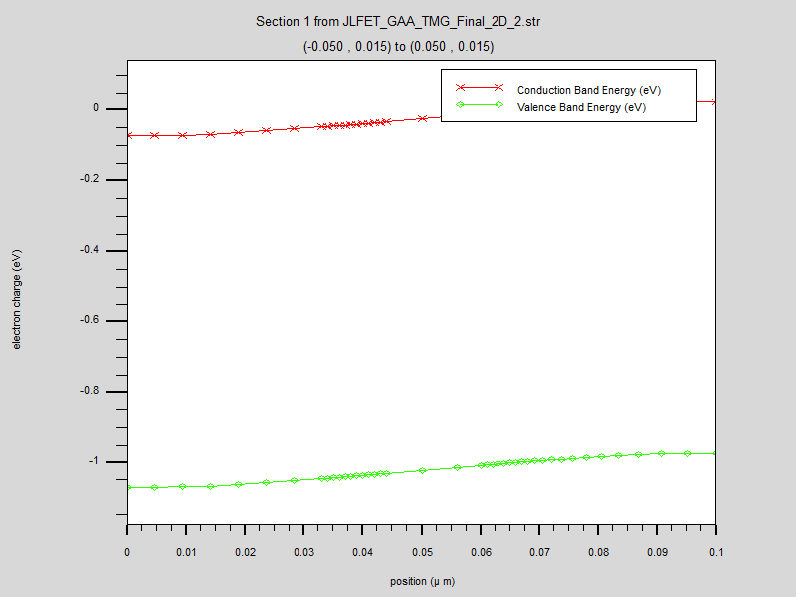
Energy band Plot

Slide 24
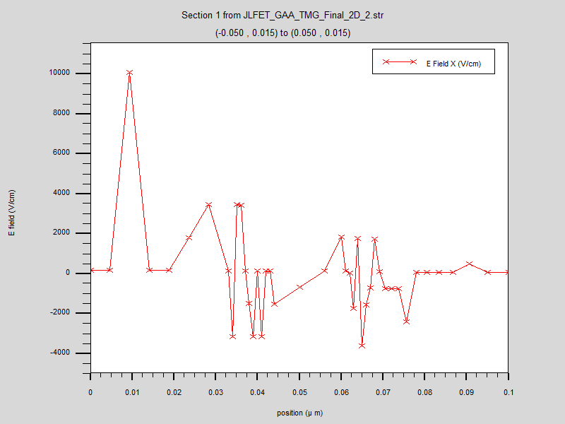
E field Plot Along X axis

Slide 25
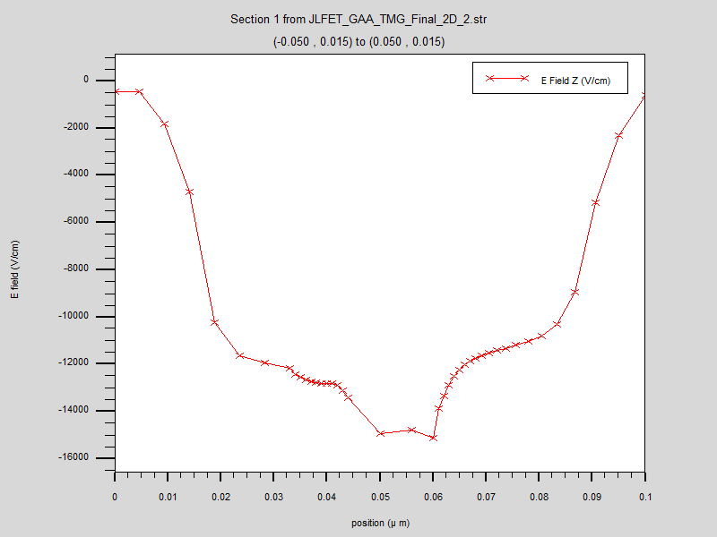
E field Plot Along Z axis

Slide 26
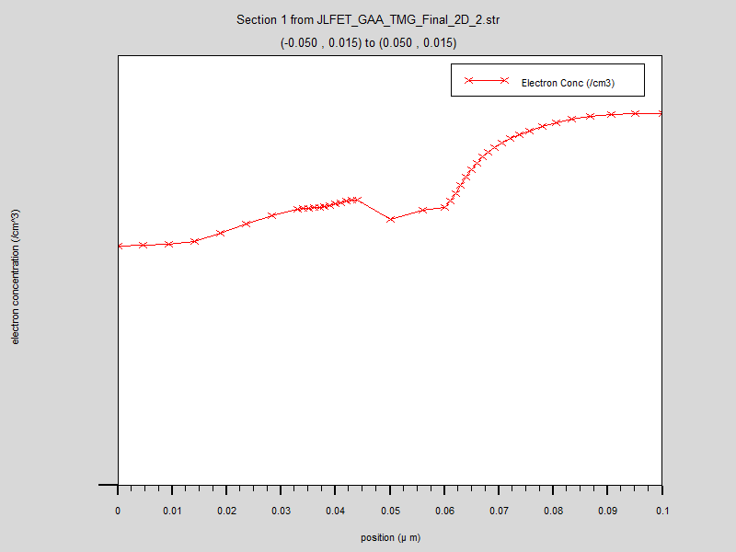
Electron concentration Plot

Slide 27
Novelty
Junctionless field-effect transistors (JLFETs) are a type of transistor that do not have a p-n junction.
One of the main advantages of JLFETs is that they have low power consumption.
They also have a high transconductance, which means they can have a large gain at low input voltages, making them useful for amplifying weak signals.
There are several novel approaches being explored for the development of JLFETs, including the use of novel materials such as graphene and Gate all-around, as well as the use of different device architectures and fabrication techniques.
Overall, the development of JLFETs is an active area of research, and there are many exciting developments and innovations on the horizon that could lead to new and improved electronic devices.

Slide 28
Objectives Met
Learned basic concepts of MOSFETS and JLFETS
Learned how to code in Silvaco TCAD
Learned how to simulate and extract various results for a given device.
Able to write code for our proposed design.
Tabulated all possible results and found out the best result
Extracted plots of various device parameters.
Able to know the importance/significance of each plot
Able to know the importance of team work
Improved our presentation skills
Started to write a research paper

Slide 29
Applications
Low-power circuits
Low-voltage circuits
Amplifiers
Switches
Sensors
Power management

Slide 30
Conclusion
The effect of the TMGs on the JLFET-GAA with regard to performance and ambipolar current was investigated using TCAD simulation.
The optimal design parameters of TMG could achieve a steep subthreshold slope and a high ON-/OFF-current ratio of approximately 10^8, when compared with those observed for conventional single-gate JLFETs.
Modulating the WFs of the TMG and the length of each MG in the JLFET-GAA could facilitate appropriate adjustment of the performance and ambipolar current, simultaneously.
Therefore, the ON-state drive current and ambipolar current could be successfully addressed by TMG engineering.

Slide 31
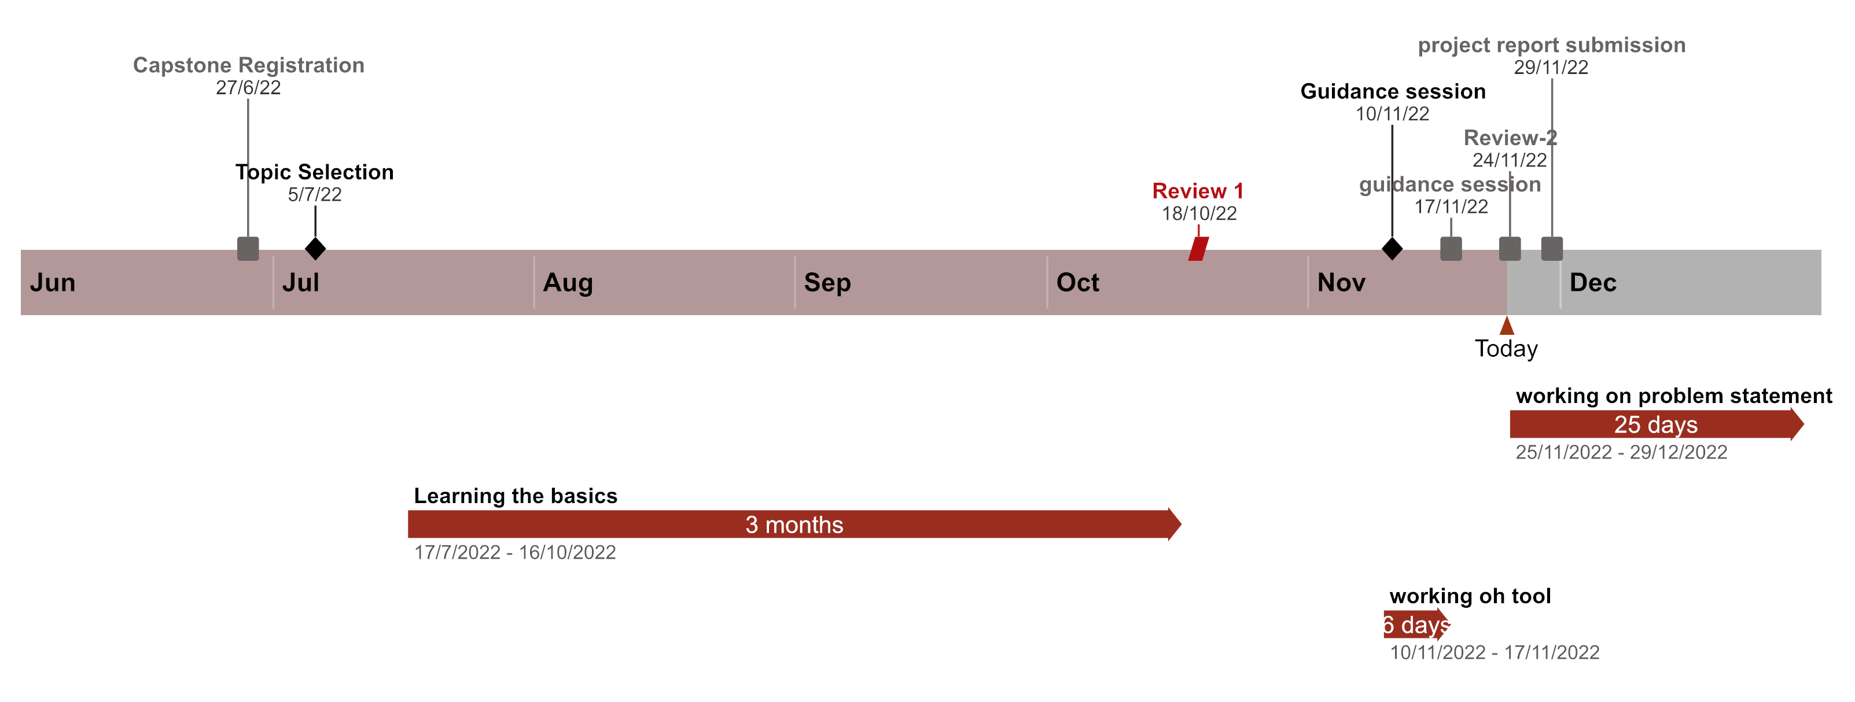
Timeline

Slide 32
References
Junctionless Field-Effect Transistors Design, Modeling, and Simulation(Book)
https://www.researchgate.net/publication/273790824_Modeling_and_simulation_of_Double_Gate_Junctionless_Transistor_considering_fringing_field_effects
https://www.researchgate.net/publication/348496381_Design_and_Investigation_of_Silicon_Gate-All-Around_Junctionless_Field-Effect_Transistor_Using_a_Step_Thickness_Gate_Oxide
https://www.researchgate.net/publication/322832988_Modeling_Nanowire_and_Double-Gate_Junctionless_Field-Effect_Transistors
https://www.researchgate.net/publication/296475363_Dielectric_pocket_double_gate_junctionless_FET_a_new_MOS_structure_with_improved_subthreshold_characteristics_for_low_power_VLSI_applications

Slide 33
THANK YOU

